Slide 1

ITC327W · PHASE 3 · FINAL PRESENTATION
Phehello Secondary Online Enrolment System
One shared Supabase backend
Flutter mobile app · ASP.NET web app
Group Ctrl-Alt-Defeat
KI. Makhoali · PIJ. Lebusa · LR. Mahlatsi
M. Lepitla · MM. Motaung · DT. Adegbola
Stakeholder: Phehello Secondary School
Notes:
[~0:30] SPEAKER: KI. Makhoali
Good day everyone. We are Group Ctrl-Alt-Defeat: KI. Makhoali, PIJ. Lebusa, LR. Mahlatsi, M. Lepitla, MM. Motaung and DT. Adegbola. We built an online enrolment system for Phehello Secondary School, our stakeholder, represented by Zukiswa Khondlo.
Today we show how our approved design became a working system: a Flutter app for parents, an ASP.NET web app for staff, and one shared Supabase backend. We will explain the problem, the solution, the architecture, then run a live demonstration, and finish with our status against the requirements.

Slide 2






Introduction · Problem and approved solution
From paper queues to a phone
Today: paper-based
Approved solution
Hand-written forms and documents carried to school
Parents apply, upload documents and track status on a mobile app
Missing papers mean repeat trips and in-person payment
Staff verify payments and decide on a web app
Parents cannot see application or payment status
One shared database keeps both apps in sync
Notes:
[~1:15] SPEAKER: KI. Makhoali
Today, enrolment at Phehello is on paper. Parents collect and hand-write forms, travel to the school with documents and pay the fee in person. If something is missing, they come back. They cannot see the status of their application, and staff spend a long time with each parent.
The solution we agreed with the school: parents apply, upload documents and proof of payment, and track their status on a mobile app. Staff verify and process everything on a web app. Both use one shared database, so the information is always the same on both sides. PIJ. Lebusa will now show how it is built.

Slide 3


Flutter Mobile Application (15) · ASP.NET Web Application (15)
One backend, two applications
Flutter mobile app
Parents and guardians
ASP.NET web app
Clerk and Administrator
Register and sign in
Submit the application
Upload documents and proof of payment
Track status and messages
Supabase
Clerk verifies payments
Admin approves, rejects or requests corrections
Notes, messages, reminders
Confirmation letters
One shared project
Authentication
PostgreSQL database
Private file storage
Row Level Security
Same project, same records: a change in one app appears in the other
Notes:
[~1:15] SPEAKER: PIJ. Lebusa
We built two applications that share one backend.
The Flutter mobile app is for parents and guardians. They register, submit the enrolment application, upload documents and proof of payment, and follow the status and messages from the school.
The ASP.NET web app is for school staff. The Financial Clerk verifies proof of payment. The Administrator reviews applications, approves, rejects or requests corrections, adds notes, messages parents, sends reminders and generates confirmation letters.
In the middle is Supabase: authentication, the PostgreSQL database and private file storage, as one project. Both apps read and write the same records, so when a parent submits, staff see it straight away, and when staff decide, the parent sees the result.

Slide 4


Shared Supabase Backend (15)
Inside the shared Supabase
11
Users
Enrolment
profiles, learners, learner_medical_info
applications, application_documents
tables built from the approved ERD
Payments
Admin
payments, school_payment_records
application_notes, application_status_history, confirmation_letters, notifications
West EU (Ireland) · one project
Supabase Auth sign-in
Row Level Security on all tables
Private storage bucket
Notes:
[~1:15] SPEAKER: PIJ. Lebusa
This is the shared Supabase backend. It holds 11 tables, built from our approved ERD: users and learners, applications and documents, payments, and the admin tables for notes, status history, confirmation letters and notifications.
[DO: Open the Supabase Table Editor in the browser. Show 3 or 4 tables with the dummy records, e.g. profiles, applications, payments. Show that Storage has a private bucket.]
Every table has Row Level Security. Documents are stored in a private bucket. Each status change is recorded in the status history, and a verified payment updates the application automatically. Both of our apps use this single project: the same URL, the same tables, the same users. LR. Mahlatsi will now explain who can see what.

Slide 5




Shared Supabase Backend (15) · access controls
Each role sees only what it needs
Parent / Guardian
Financial Clerk
Administrator
Creates and reads only their own learners, applications, documents and payments. Cannot approve anything.
Reads payments and school payment records and verifies payments. No access to applications.
Reads all applications and documents. Approves, rejects or requests corrections. Cannot verify payments.
Tested with dummy data: Parent 2 reads 0 rows of Parent 1's records, and the Clerk reads 0 rows of applications. No delete rights keeps the audit history.
Notes:
[~0:45] SPEAKER: LR. Mahlatsi
Access is controlled by role, and it is enforced in the database itself, not only in the screens.
A parent sees only their own learners, applications, documents and payments. The Financial Clerk can read payments and school payment records and verify payments, but cannot open applications. The Administrator reviews every application and decides on it, but cannot verify payments.
We tested this with dummy data: a second parent could not read the first parent's records, and the Clerk could not read or change applications. Both returned zero rows, which is the correct result. Nobody has delete rights, so the history is kept. M. Lepitla will now start the live demonstration.

Slide 6



Final SRS and Implementation Evidence (5) · approved changes and known limitations
Decisions and limitations
Six fields added
The wireframes needed fields the ERD lacked, such as grade applied for, initials and siblings at school.
Known limitations
No payment gateway: the Clerk checks proof of payment
Prototype uses dummy data only
Mobile interface targets a standard Android phone
Save and Close
Parents can finish later: a saved application waits on Home with Continue and Delete. Lecturer advice.
Clearer charts
Dashboard charts show days of the week against totals that add up. Lecturer feedback.
Notes:
[~0:45] SPEAKER: DT. Adegbola
We made three decisions while building. First, the approved wireframes needed six fields that the database did not have, for example grade applied for, initials and siblings at school, so we added them and updated the submit function. Second, on our lecturer's advice, we added Save and Close so a parent can finish an application later. Third, after lecturer feedback, we made the dashboard charts clearer.
Our limitations are clear: this is a prototype with dummy data only, there is no payment gateway because the Clerk checks the proof of payment, and the mobile interface targets a standard Android phone.

Slide 7

Final SRS and Implementation Evidence (5) · requirement-to-function status
Project status: requirements met
Functional requirements 15 of 15 met
FR1 Sign-up & login
FR2 Submit application
FR3 Upload documents
FR4 Proof of payment
FR5 View status
FR6 Verify payment
FR7 View applications
FR8 Approve / reject
FR9 Notes
FR10 Message parent
FR11 Reminders
FR12 Confirmation letter
FR13 Application count
FR14 Store in Supabase
FR15 Fee & bank details
Non-functional requirements 6 of 6 met
NFR1 Staff access only
NFR2 Secure storage
NFR3 Test data only
NFR4 Clear errors
NFR5 Android display
NFR6 Role-based access
Notes:
[~1:00] SPEAKER: DT. Adegbola
Here is where we are against the approved SRS. All 15 functional requirements are implemented: from registering and submitting, through payment verification and approval, to notes, messages, reminders, confirmation letters and the application count, with everything stored in Supabase. All 6 non-functional requirements are met: staff-only access, secure storage, test data only, clear error messages, Android display and role-based access.
Both shared processes you just saw work end to end between the Flutter app and the ASP.NET app on the same Supabase project. KI. Makhoali will now show our project records.
NOTE FOR THE GROUP: before presenting, make sure every tick on this slide is true for the demonstrated version. Change any chip you cannot show working.

Slide 8



Microsoft Project, GitHub and Progress Tracker (5)
Project records and source code
Microsoft Project
Project Schedule.mpp
GitHub
WIL-Project-2026 (private)
Progress Tracker
ITC327W Excel workbook
Editable schedule with 3 phases
Tasks, dates, dependencies and milestones
Percentage complete per task
Code for both apps, with README and setup guide
All members have access
No keys or passwords committed
Tasks and member contributions
Challenges we faced
Final group reflection
Evidence screenshots on the next three slides
Notes:
[~1:00] SPEAKER: KI. Makhoali
These are our project records, as listed in the rubric.
[DO: Open Project Schedule.mpp. Scroll through the three phases, show the dates, dependencies and percentage complete.] Our editable Microsoft Project schedule, updated with our actual progress.
[DO: Open the GitHub repository WIL-Project-2026 in the browser (it is private, so sign in first). Show the README, the folders for the Flutter app and the ASP.NET app, and the recent commits.] The repository holds the version we are demonstrating today, with a README and setup guidance. All members have access, and no keys or passwords are committed.
[DO: Open the ITC327W Progress Tracker workbook. Show the task and contribution sheets, the challenges and the group reflection.] The tracker records our tasks, each member's contributions, our challenges and the final group reflection.
BEFORE PRESENTING: have all three open in tabs or windows so you do not search for them in front of the panel.

Slide 9
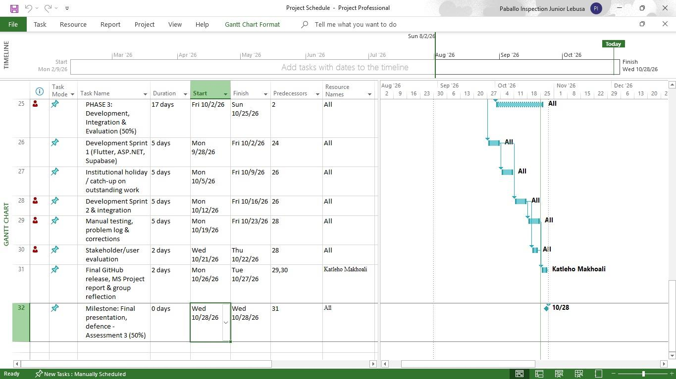
Microsoft Project, GitHub and Progress Tracker (5)
Microsoft Project schedule

Slide 10
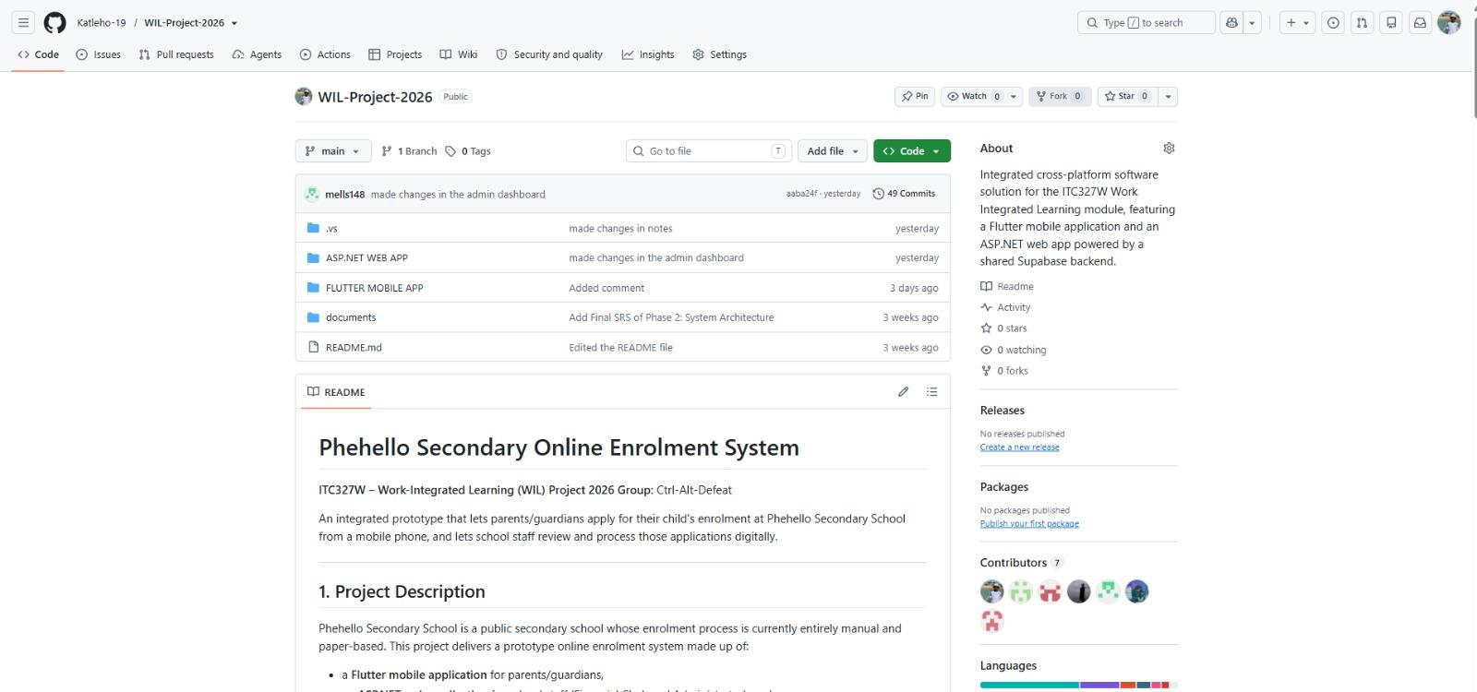
Microsoft Project, GitHub and Progress Tracker (5)
GitHub repository

Slide 11
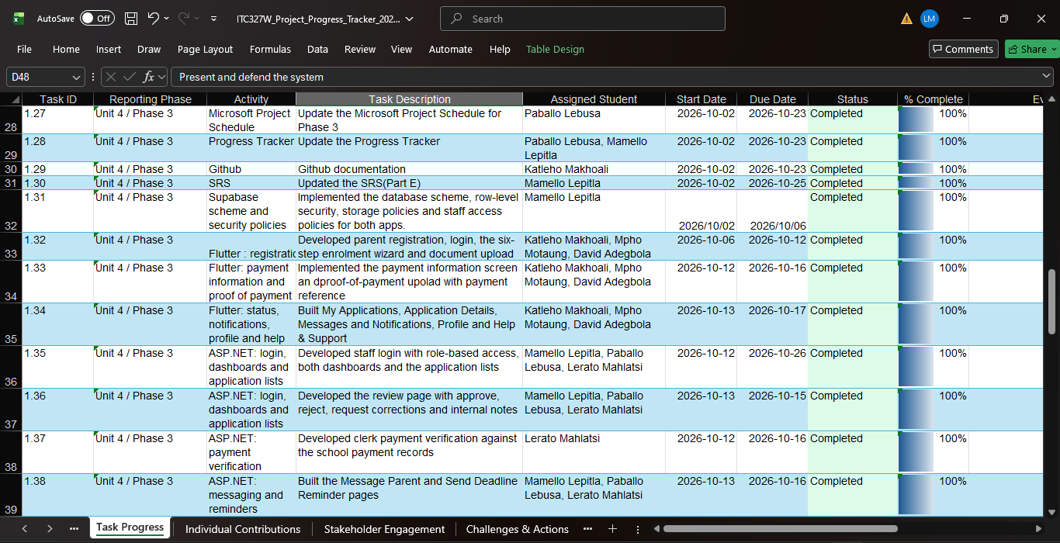
Microsoft Project, GitHub and Progress Tracker (5)
Progress Tracker

Slide 12

Stakeholder confirmation · evidence video
Stakeholder confirmation
What was confirmed
Phehello Secondary School reviewed the Phase 3 system
Parent, Financial Clerk and Administrator functions
All learner and parent data shown was fictional
Stakeholder confirmation video
Form: Stakeholder Confirmation of Phase 3 Deliverables
Notes:
[~1:00] SPEAKER: LR. Mahlatsi
Our stakeholder, Phehello Secondary School, reviewed the Phase 3 system and confirmed the deliverables on the Stakeholder Confirmation form. Here is the video of that confirmation.
[DO: Play the video. Keep it to about 1 minute: if the recording is longer, play the key part only.]
TO ADD THE VIDEO (before presenting): in PowerPoint, Insert > Video > This Device, choose the file, then resize and place it over the dark frame. Set Playback > Start: On Click. Test the sound in the room. Have the video file saved next to the presentation as a backup.

Slide 13
Thank you
Questions?
Group Ctrl-Alt-Defeat · ITC327W Phase 3 · Phehello Secondary School
Notes:
[~0:15, then questions] Questions from the panel. Any member may answer; the member who built that part answers first. Backend and security: PIJ. Lebusa / LR. Mahlatsi. Project records and GitHub: KI. Makhoali. Flutter: M. Lepitla. ASP.NET: MM. Motaung. Changes and status: DT. Adegbola. Introduction and problem: KI. Makhoali.

